Slide 1
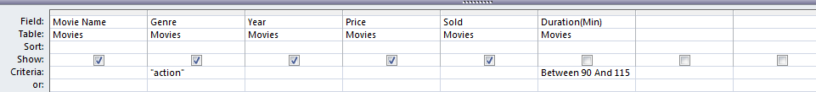
Before you make the report you need to create and save the Query as DVDs Total Sales . Make a query showing the following Fields: Movie Name, Genre, Year, Price and Sold Show only the records which include: Action Movies and the duration is Between 90 and 115 Minutes Insert a new field called Monthly Sales which is calculated at run-time – You need to multiply the Sold by the Price Field Insert a new field called Projected Annual Sales which is calculated at run-time - You need to multiply the Monthly Sales Field * 12 Format the new fields as a currency.
Produce a Report: Fits on a single page wide ---- Has a page orientation of Portrait Count the total number of Movies (Label – Count of Movies) Calculate the Total Sum, Max, Min and Average (AVG) for the Monthly Sales
Two new fields

